Slide 1


<Name>
<Date>

Slide 2

Outline
Executive Summary
Introduction
Methodology
Results
Conclusion
Appendix

Slide 3
Executive Summary
Summary of methodologies
-Data Collection from API and Web Scraping
-Data Wrangling
-Exploratory Data Analysis with SQL,Pandas and Matplotlib
-Interactive Visual Analytics and Dashboard with Folium and Plotly Dash
-Predictive Analysis
Summary of all results
-Finding best Hyperparameters for models
-The model that best performs using test data

Slide 4
Introduction
As SpaceY we want to achieve to a point that launching rockets will not be expensive anymore.By reusing our rockets first stage this seems possible.
We can determine whether the landing will be successful or not by applying Machine Learning and Data Science to the existing data.

Slide 5

Section 1

Slide 6
Methodology
Executive Summary
Data collection methodology:
Data is collected from the SPACEX REST API and web scraping from Wikipedia.
Perform data wrangling
Original JSON and HTML table data is converted to dataframe for visualization and analysis using Pandas library
Perform exploratory data analysis (EDA) using visualization and SQL
Perform interactive visual analytics using Folium and Plotly Dash
Perform predictive analysis using classification models
Using Machine Learning to determine if the first stage of Falcon9 will land successfully

Slide 7
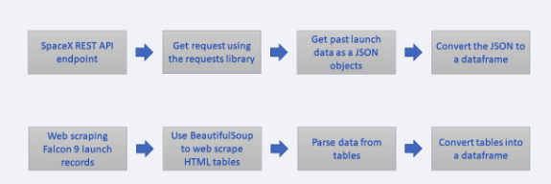
Data Collection
Data is collected from the SPACEX REST API and web scraping from Wikipedia.

Slide 8
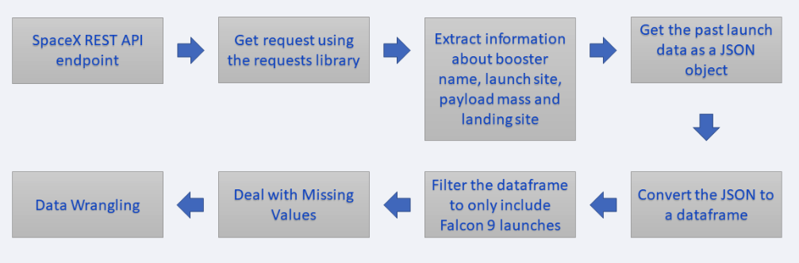
Data Collection – SpaceX API
https://github.com/noob3192/SpaceX

Slide 9
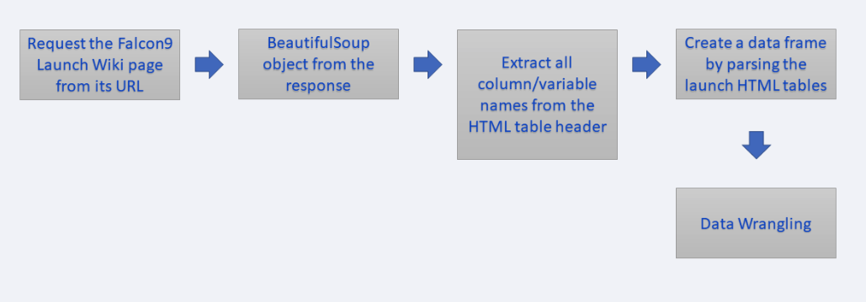
Data Collection - Scraping
https://github.com/noob3192/SpaceX

Slide 10
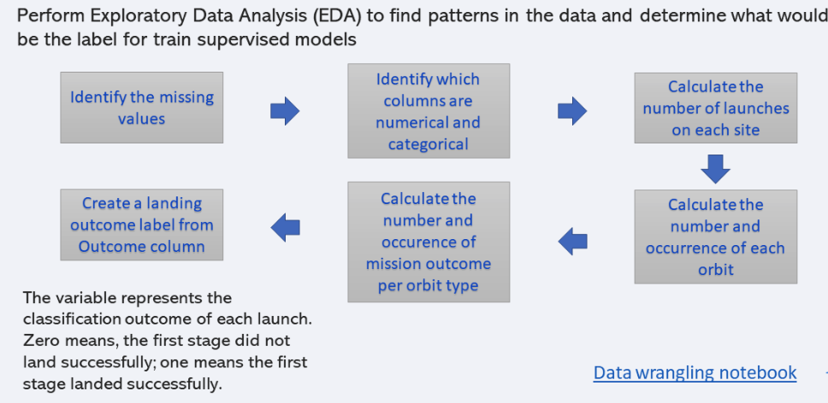
Data Wrangling
https://github.com/noob3192/SpaceX

Slide 11
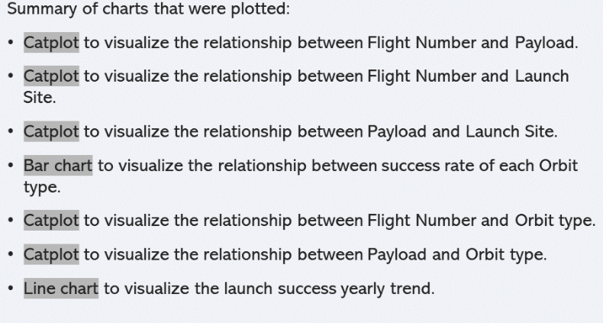
EDA with Data Visualization
https://github.com/noob3192/SpaceX

Slide 12
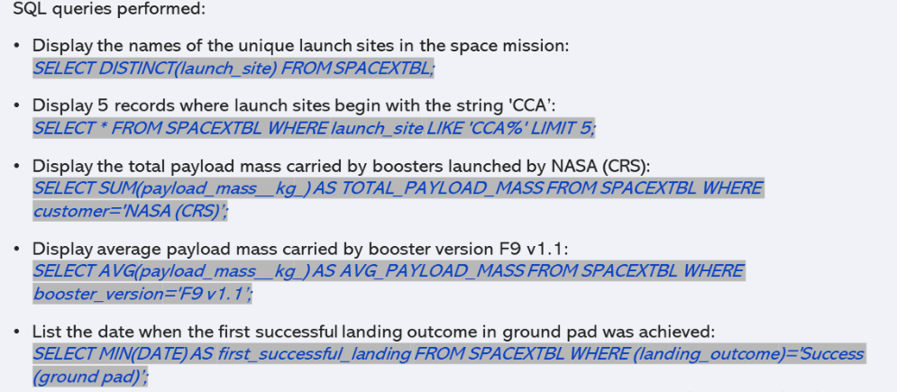
EDA with SQL
https://github.com/noob3192/SpaceX

Slide 13
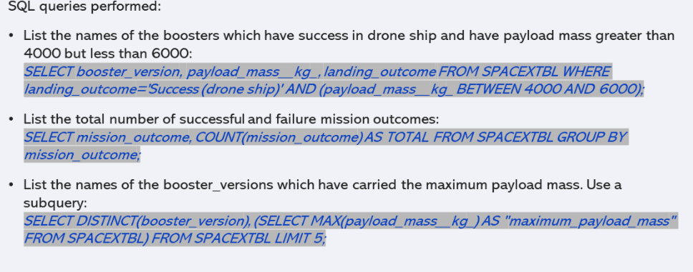
EDA with SQL
https://github.com/noob3192/SpaceX

Slide 14
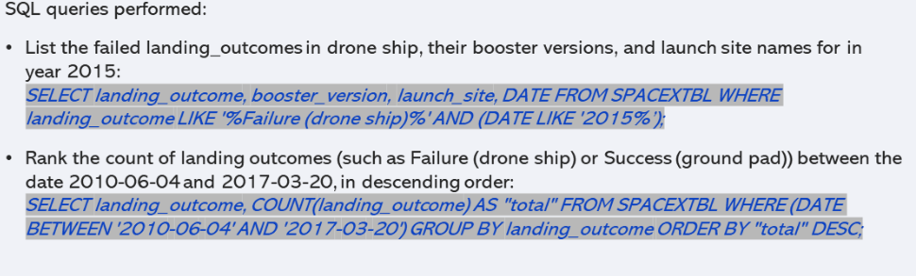
EDA with SQL
https://github.com/noob3192/SpaceX

Slide 15
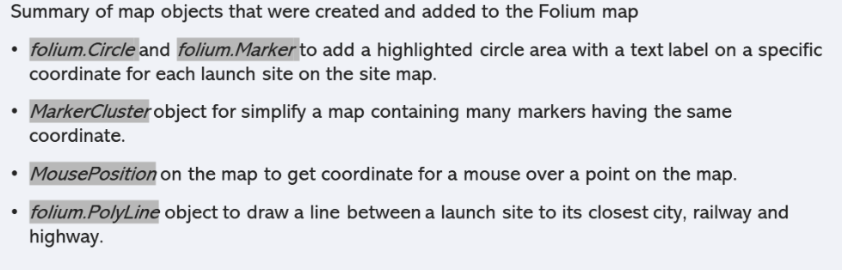
Build an Interactive Map with Folium

Slide 16
EDA with SQL
https://github.com/noob3192/SpaceX

Slide 17
EDA with SQL
https://github.com/noob3192/SpaceX

Slide 18
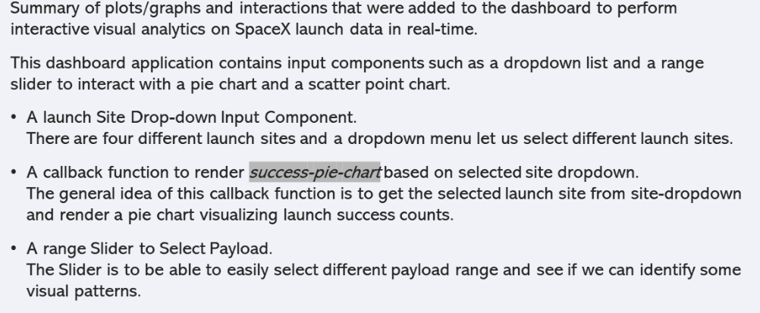
Build a Dashboard with Plotly Dash
https://github.com/noob3192/SpaceX

Slide 19
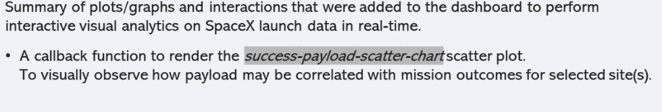
Build a Dashboard with Plotly Dash
https://github.com/noob3192/SpaceX

Slide 20
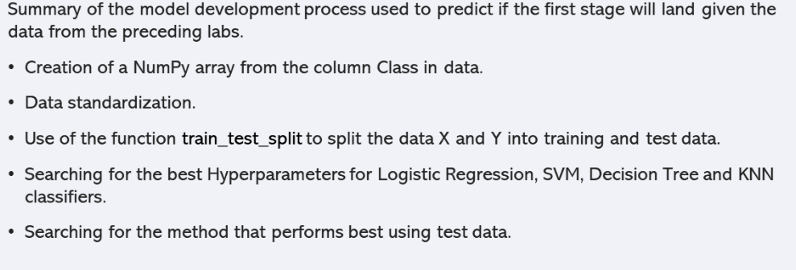
Predictive Analysis (Classification)
https://github.com/noob3192/SpaceX

Slide 21
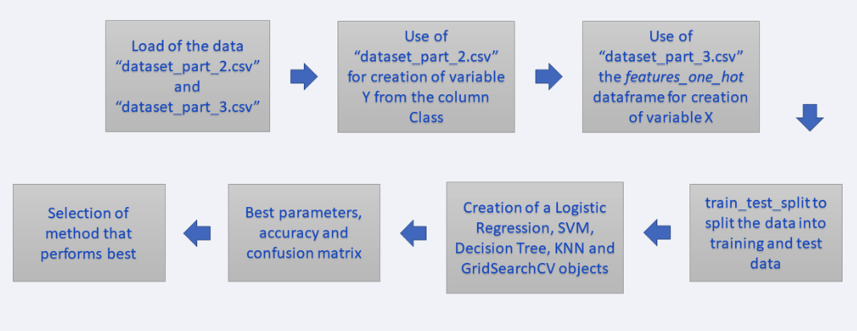
Predictive Analysis (Classification)
https://github.com/noob3192/SpaceX

Slide 22
Results
Exploratory data analysis results
Interactive analytics demo in screenshots
Predictive analysis results

Slide 23

Section 2

Slide 24
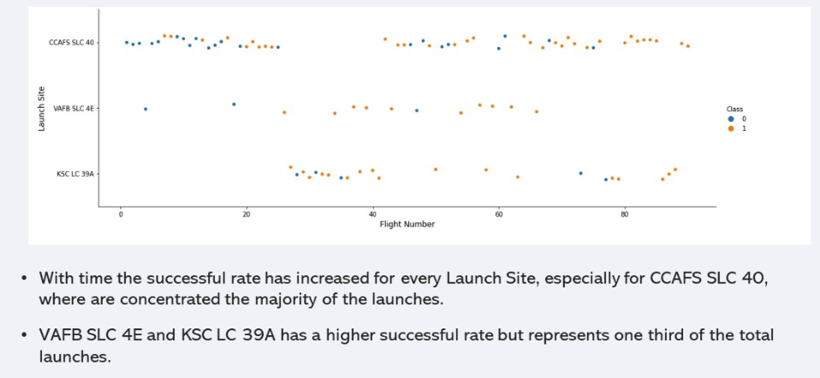
Flight Number vs. Launch Site

Slide 25
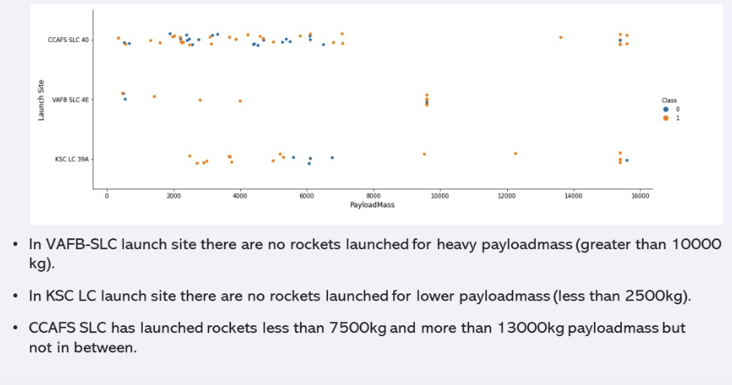
Payload vs. Launch Site

Slide 26
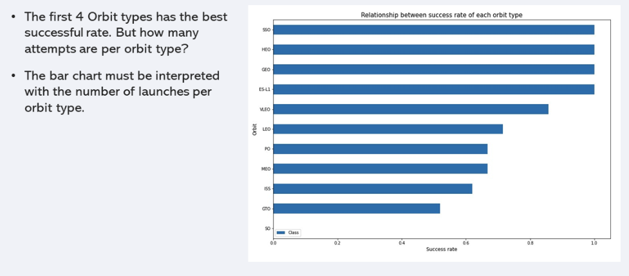
Success Rate vs. Orbit Type

Slide 27
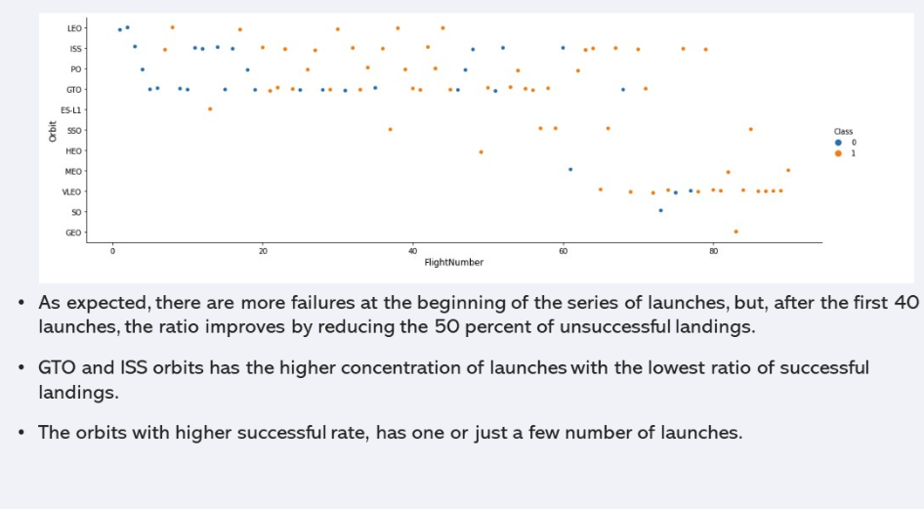
Flight Number vs. Orbit Type

Slide 28
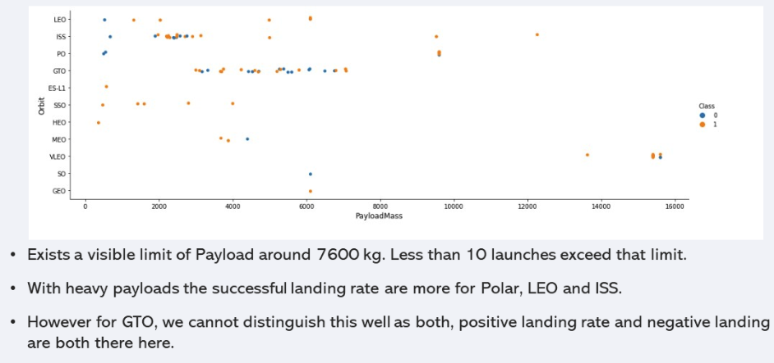
Payload vs. Orbit Type

Slide 29
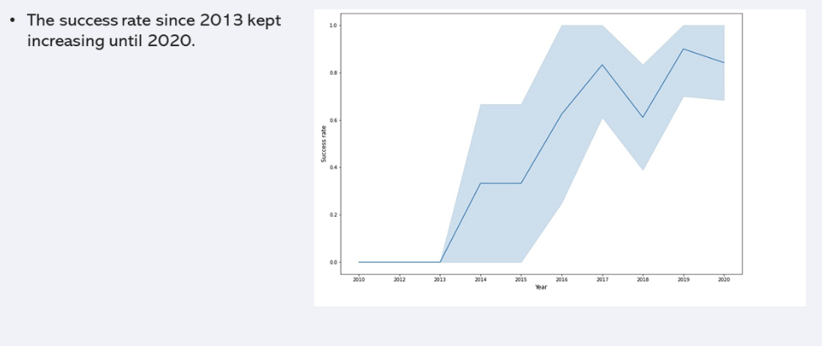
Launch Success Yearly Trend

Slide 30
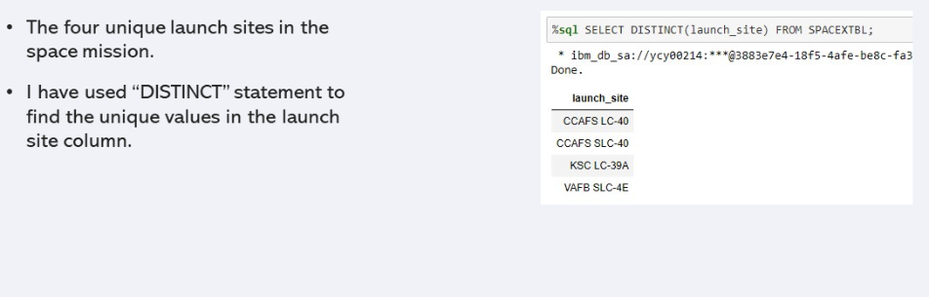
All Launch Site Names

Slide 31
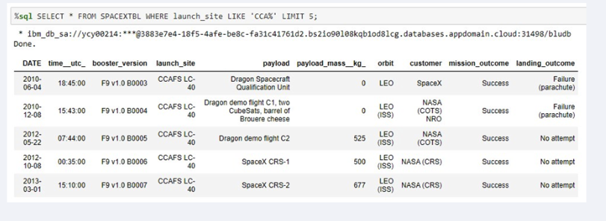
Launch Site Names Begin with 'CCA'
Find 5 records where launch sites begin with `CCA`
Present your query result with a short explanation here

Slide 32
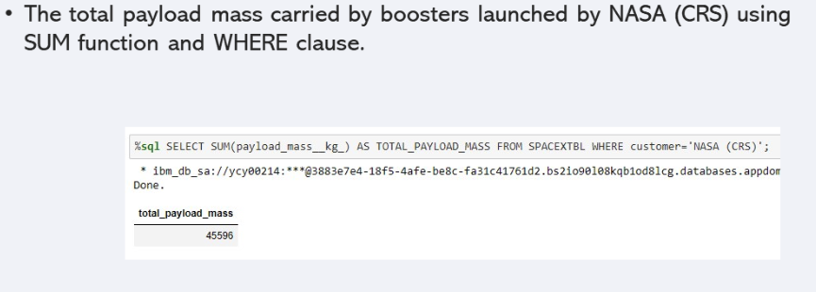
Total Payload Mass

Slide 33
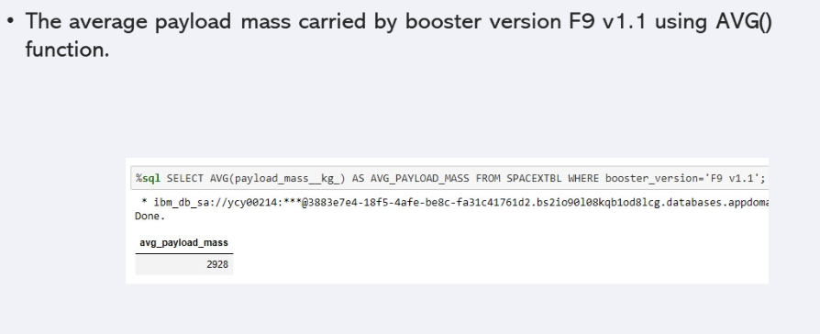
Average Payload Mass by F9 v1.1

Slide 34
First Successful Ground Landing Date
Find the dates of the first successful landing outcome on ground pad
Present your query result with a short explanation here

Slide 35
Successful Drone Ship Landing with Payload between 4000 and 6000
List the names of boosters which have successfully landed on drone ship and had payload mass greater than 4000 but less than 6000
Present your query result with a short explanation here

Slide 36
Total Number of Successful and Failure Mission Outcomes
Calculate the total number of successful and failure mission outcomes
Present your query result with a short explanation here

Slide 37
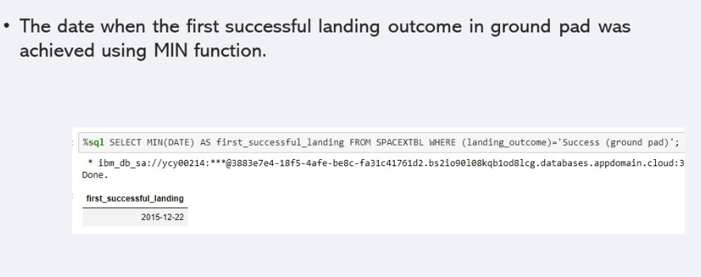
Boosters Carried Maximum Payload

Slide 38
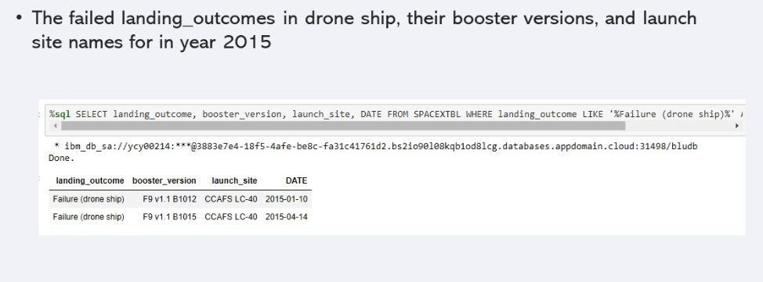
2015 Launch Records

Slide 39
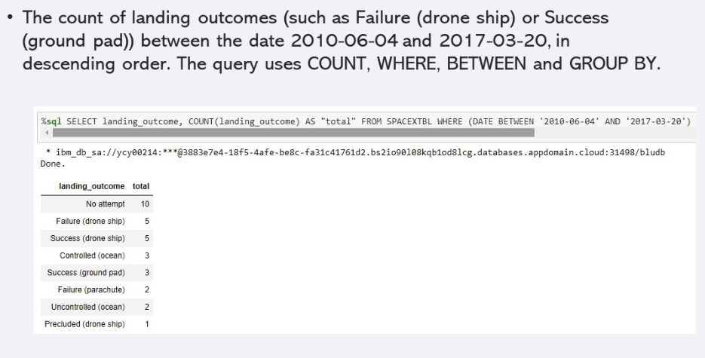
Rank Landing Outcomes Between 2010-06-04 and 2017-03-20

Slide 40

Section 3

Slide 41
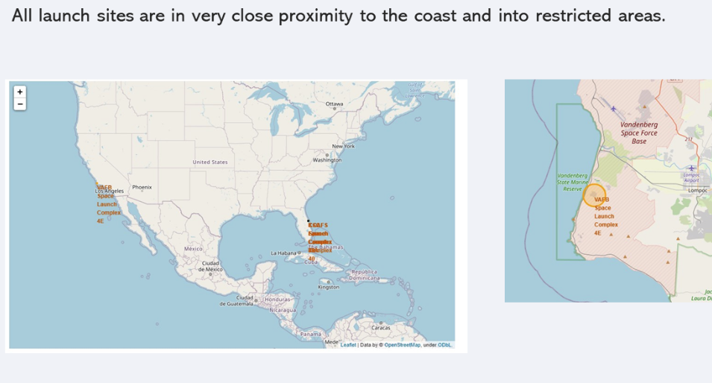
Launch Sites

Slide 42
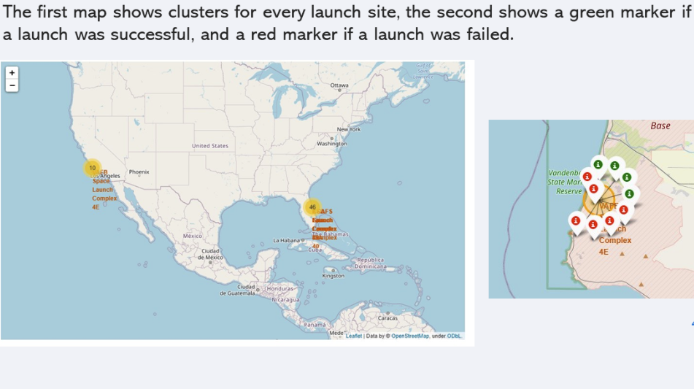
Launch Classification

Slide 43
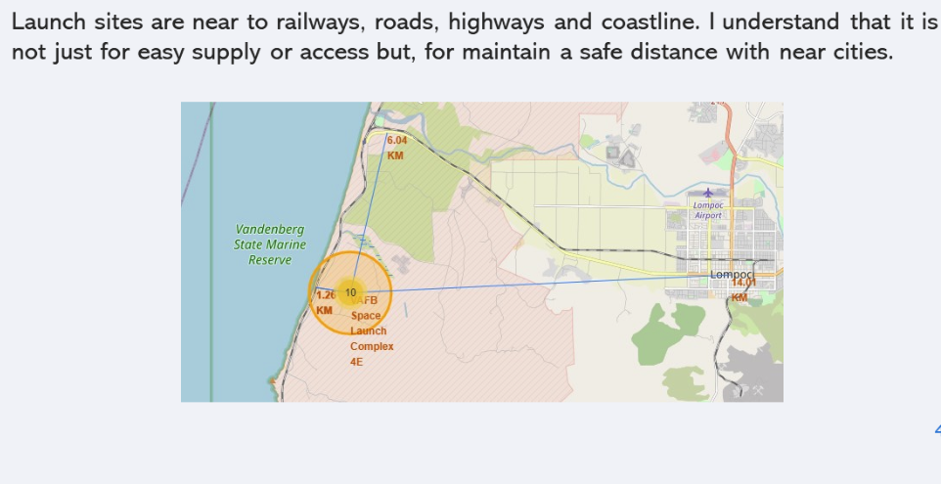
Launch Site Proximity

Slide 44

Section 4

Slide 45
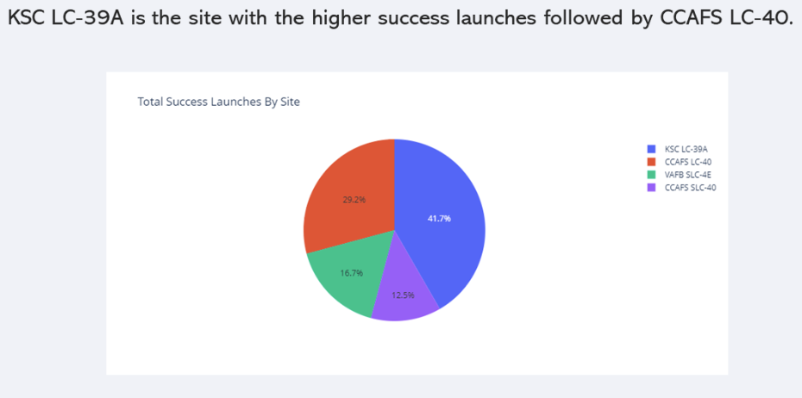
Total Success

Slide 46
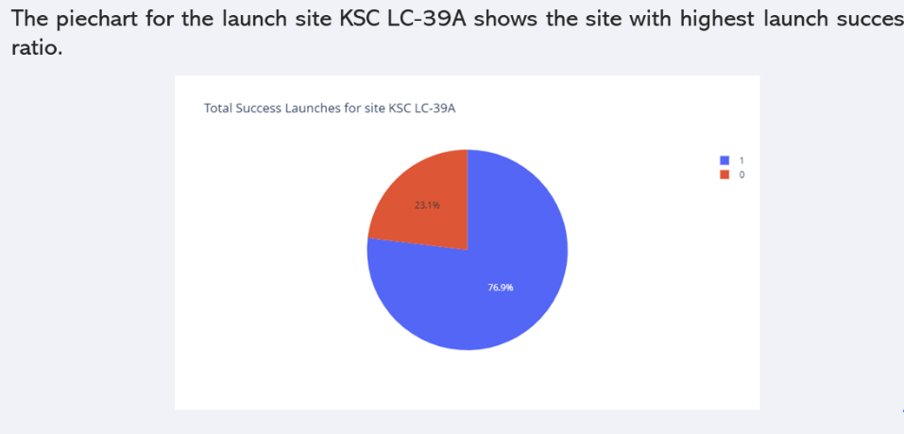
KSC LC-39A

Slide 47
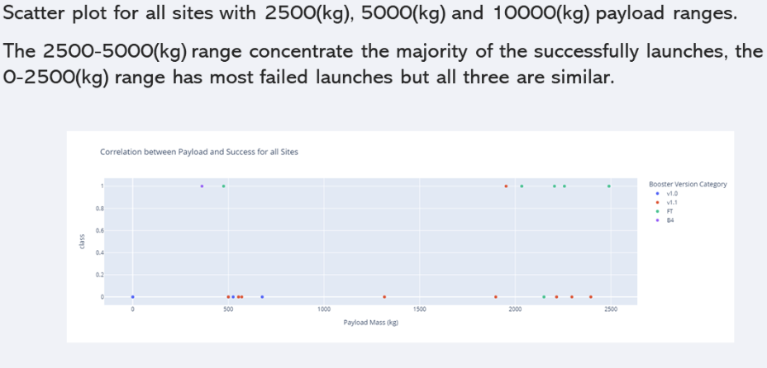
PAYLOAD VS LAUNCH

Slide 48

Section 5

Slide 49
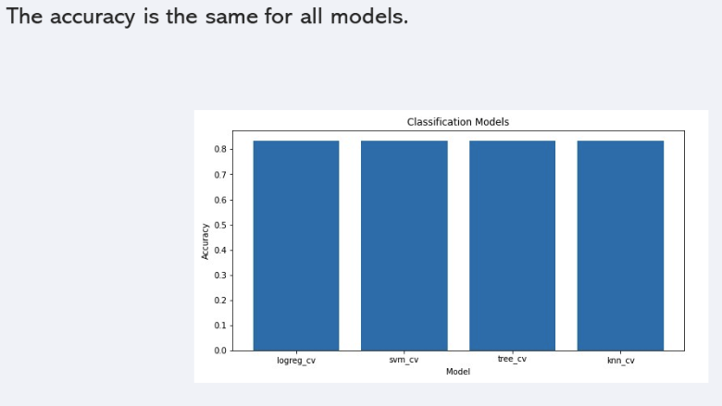
Classification Accuracy

Slide 50
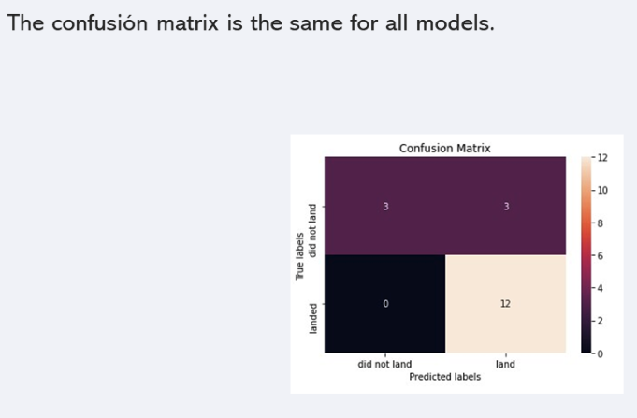
Confusion Matrix

Slide 51
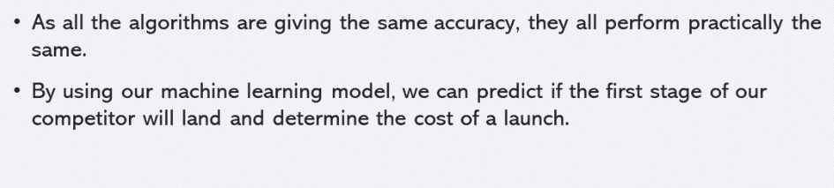
Conclusions

Slide 52
Appendix
https://github.com/noob3192/SpaceX

Slide 53


